Slide 1



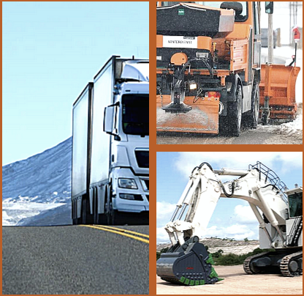
WELCOME
BY THE MODERATOR
Thomas FABIAN, ACEA
9:30
ALBATTS PROJECT INTRO
Lukáš FOLBRECHT, Czech Automotive Industry Association / ALBATTS Work Package leader
9:35
ELECTRIFICATION OF HEAVY-DUTY VEHICLES:
WHAT SKILLS AND COMPETENCIES WILL BE NEEDED?
AGENDA
November 29th 2022
09:30-11:00 CET
Online
EXPERTS PRESENTATIONS
Sustainable transport solutions Fredrik ELIESON, Volvo Group Battery expert perspective Jan VEJBOR, EVC Group User perspective Markus DÖHN, Deutsche Post DHL Group Servicing & Maintenance Michael WOLF, Daimler Truck
9:40
Q&A
Moderated by Thomas FABIAN
10:30
CLOSING REMARKS
Thomas FABIAN, ACEA
10:50

Slide 2
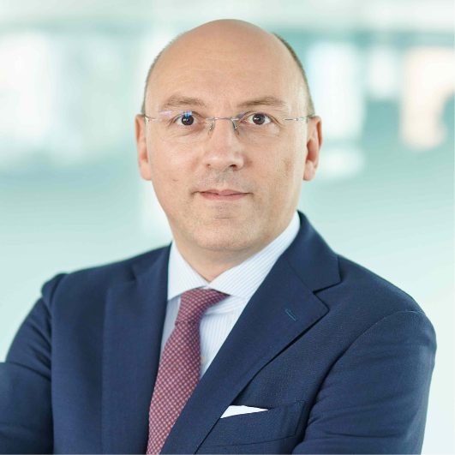
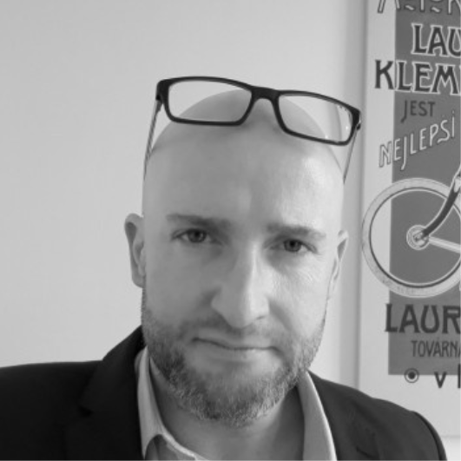
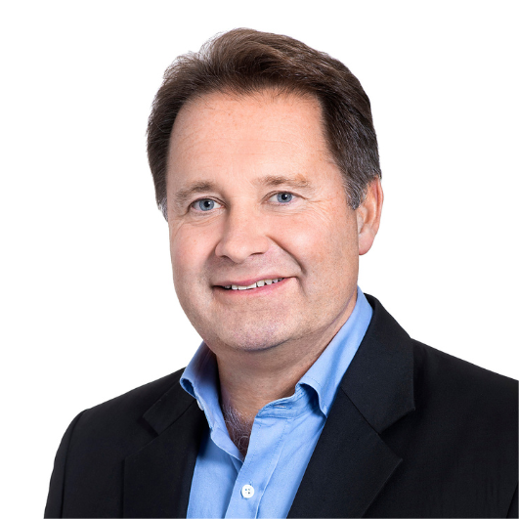
Thomas FABIAN joined the European Automobile Manufacturers’ Association (ACEA) as Commercial Vehicle Director in November 2018. ACEA represents the EU’s seven major truck producers. In previous roles, Thomas served as: Head of the Department Commercial Vehicles, Trailers, Bodies and Buses of the German Association of the Automotive Industry (VDA); Secretary General of the International Association of the Body and Trailer Building Industry (CLCCR); Director Transport Policy for the German Airports Association (ADV); and Senior Manager Transport Policy for the Federation of German Industries (BDI). Before that, he worked as Scientific Advisor to a member of the German Parliament. Thomas holds a degree in transport engineering of the Technical University of Berlin and has been working on international transport policy projects ever since graduating in 2000.
ELECTRIFICATION OF HEAVY-DUTY VEHICLES:
WHAT SKILLS AND COMPETENCIES WILL BE NEEDED?
AGENDA
November 29th 2022
09:30-11:00 CET
Online
Lukáš FOLBRECHT has been leading ALBATTS project Work Package 5 – Intelligence in Mobile Battery Applications, which has been analysing the use of battery technologies and relevant job roles and skills in moving devices, such as electric passenger cars, buses, trucks, but also motorcycles, aerospace, trains and city micromobility devices across their whole value chain. His previous experience includes positions in SKODA AUTO, the Office of the Government of the Czech Republic and the media, as well as work and study experience in the US, the UK and Brussels. Lukas is also a secretary of the Czech E-mobility Platform and an e-mobility enthusiast.
Fredrik ELIESON is Responsible Competence Transformation & Senior Project Manager at Volvo Group Operations. With more than 20 years of experience from different leading positions in industrial- and digitally-based start-up organisations in the automotive industry by establishing new organisations into stable and profitable business operations in a global environment. Fredrik is supporting the organisational competence readiness for the future by enabling access to valuable and individualised competence solutions and government funding to support the transformation journey. Since 2014, he has worked with the competence development of employees and organisations through building-up Volvo Group University. He is leading several competence transformation initiatives to secure the readiness and financial funding for the ongoing technology shift in the automotive manufacturing industry. Additionally, Fredrik has experience from several leading positions in building up industrial and technology start-ups plus leading positions in the financial areas being CFO and investment director in the venture capital profession.

Slide 3
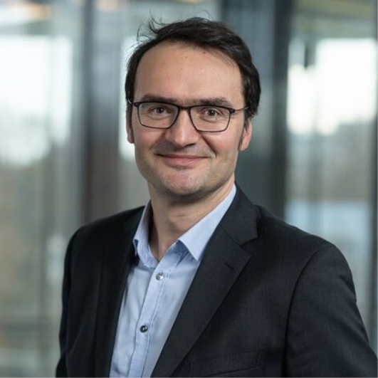
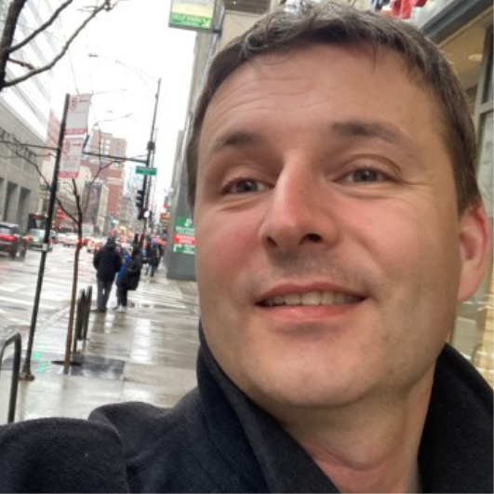
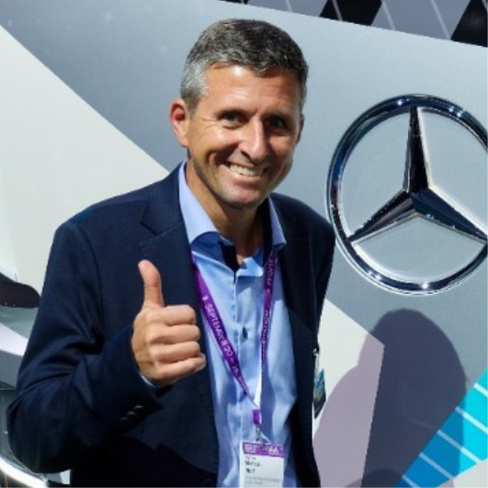
Markus DÖHN is a Senior Expert Electromobility at the Deutsche Post DHL Group, where he started working in 2008. Previously to that, he had been working for four years at the Deutsche Post as a Consultant. He studied at the Europäische Hochschulen, where he got his diploma.
ELECTRIFICATION OF HEAVY-DUTY VEHICLES:
WHAT SKILLS AND COMPETENCIES WILL BE NEEDED?
AGENDA
November 29th 2022
09:30-11:00 CET
Online
Jan VEJBOR is EVC Group Head of Sales and member of board of the Czech Battery Cluster. In more than 15 years in e-mobility and RSE market, Jan specialises in sales of traction battery systems for personal and heavy-duty vehicles, the scope being recently widened by home and industry ESS portfolio. Being in contact with li-ion cell producers and with cell recycling companies, Jan focuses on the overall picture of the li-ion battery life-cycle.
Michael WOLF is R&D project manager zero emission vehicles at Daimler Truck AG and, after many years of experience in developing heavy duty trucks and light vans at Daimler Trucks, he is fully inspired to be part of the transformation in the commercial vehicle industry. As a technical project manager of the Mercedes Benz eActros long-haul, he is facing all aspects of challenges regarding technology, organisation and volatile market environments. Michael believes in the future of zero emission transportation and supports the Paris climate goals.

